Slide 1

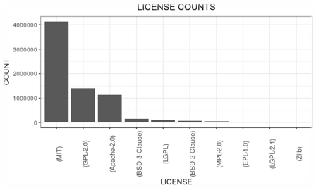
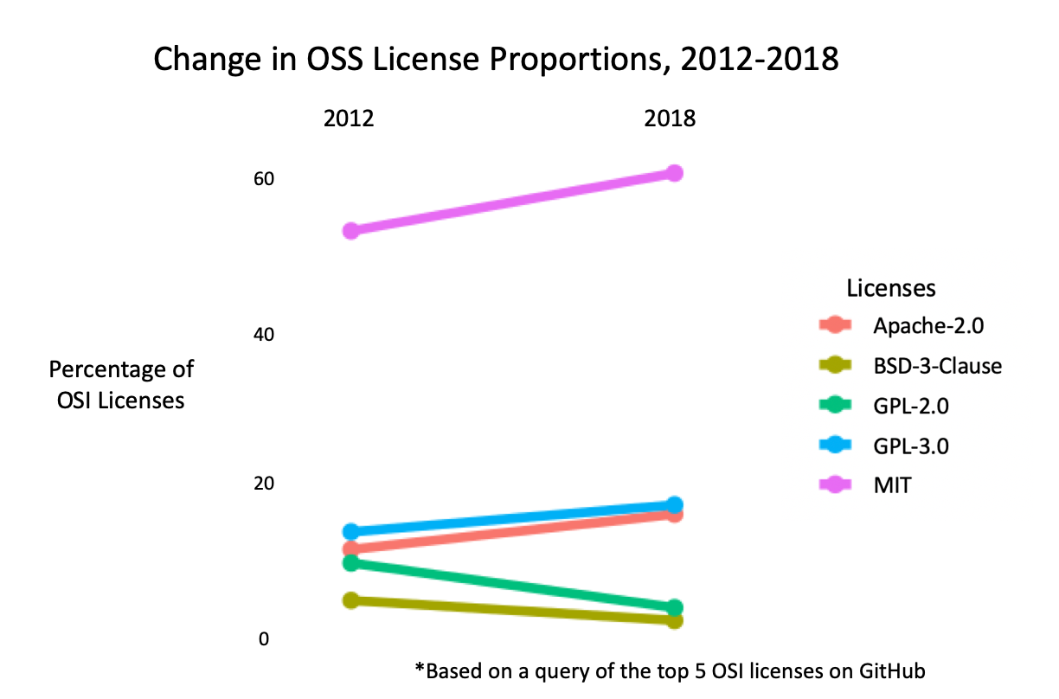
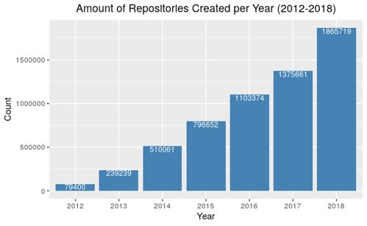
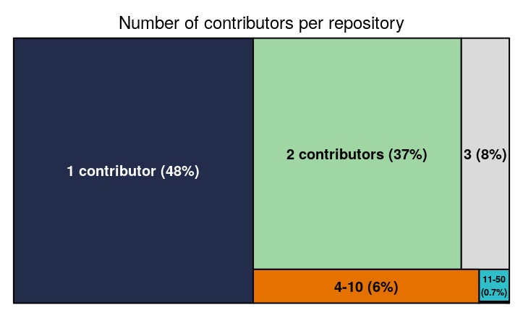
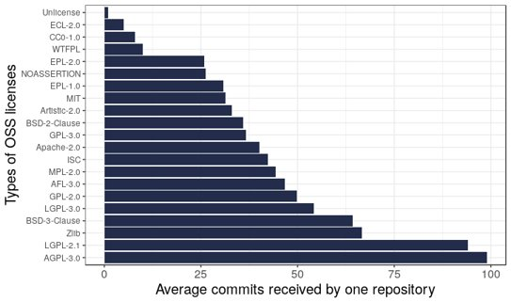
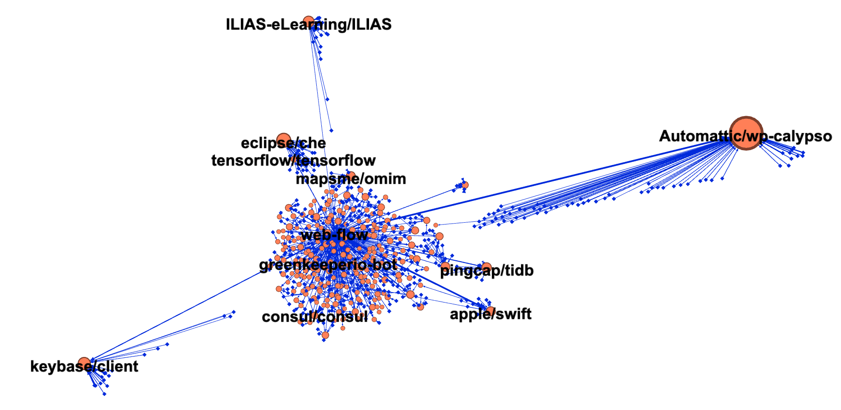
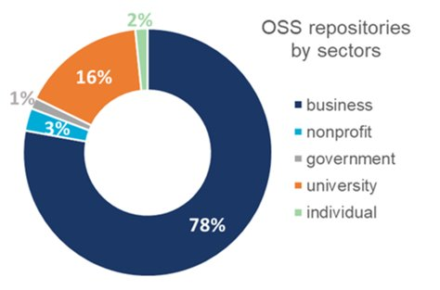
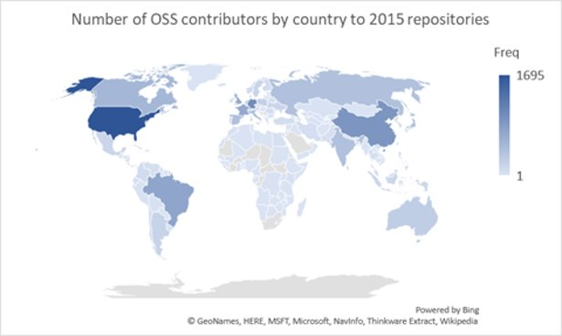
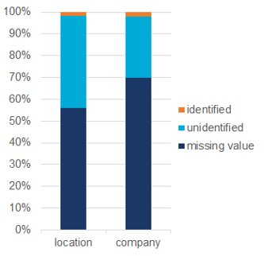

MEASURING THE UNIVERSE OF
OPEN SOURCE SOFTWARE
Your Name, Graduate Student Name, Post Doc Name, Advisor
Department Listing with captions if needed
Project Introduction
Despite the importance of open source software (OSS) to scientific innovation, there are no commonly used metrics to measure the amount of OSS in existence.
This project aims to measure how much OSS exists and to better understand the distribution of OSS creation across various sectors in order to evaluate the economic impact of OSS
Traditional measures of innovation look at the amount of copyright, patents, and trademarks in existence. However, this method does not accurately capture the universe of OSS innovation. After a data exploration of all the copyright computer files on copyright.gov, the team identified 55 OSS files. This is far too small to serve as an accurate measurement of OSS. As such, we changed our definition of the universe to licenses hosted on GitHub—a webservice that holds much of the internets code.
What is OSS?
What is the Open Source Initiative (OSI)?
What is OSS license
According to OSI, OSS is defined as: "a computer software, with its source code made available with a license, in which the copyright holder provides the rights to study, change, and distribute the software to anyone and for any purpose."
OSI is a worldwide non-profit that works to spread knowledge about OSS, promote its usage, connect various OSS communities.
Licenses define the limitations of use for code and provide developers with claims when the terms are violated. There are various types of licenses. To qualify as an OSS license, a license must allow software to be freely used, modified and shared.
What is the OSS Universe?
GitHub Terminology
This project defines the OSS universe as all GitHub repositories that have a registered OSI approved license.
GitHub - world's largest place for developers to discover, share, and build software.
Repository - contains all of a project's files Commit - an individual change to a file
Contributor - someone who successfully committed to a project (GitHub Glossary)
Licenses
Licenses define the limitations of use for OSS and provide developers with claims when licenses are violated. Holders can choose from various types of licenses.
Data Collection Methods
Querying GitHub for the OSS licenses, resulted in over 7 million OSI-license holding repositories on GitHub. We used multiple sources to access information on them.
Using GraphQL, (GitHubs current API system), we searched for repository names, owners, and license information for each of the OSI approved licenses.
  - There are 13 licenses with more than 10,000 repositories on GitHub; these 13 make up >99% of all OSS repos. We collected information on these repos from 2012-2018.
This reponames and owners were used to collect more information from an alternative online database, GHTorrent
  - Access to more information on each repository contributors including location, organization, and commit count
Data Analysis
In the period 2012-2018 there were 55,110,925 distinct repositories with commits made on GitHub. Of those 4,940,788 repositories were Open source. In other words, OSI approved repositories make up 8.97% of all projects on GitHub.
Repositories by license:
The graph to the right shows the change in proportion of the top five licenses among OSS repositories across time. MIT has by far the most with 4.1 million repositories. Apache has the second most in aggregate with 1.1 million repositories. GPL-3.0, GPL-2.0, and BSD-3 have 1.0 million, 0.4 million, and 0.2 million repositories, respectively.
MIT, GPL-3.0 and Apache have been increasing in proportional usage. These licenses are generally more permissive. Over the same period of time, GPL-2.0 and BSD, more restive licenses have decreased.
Graph Description: This graph looks at the top licenses by amount. The MIT license is the most heavily utilized, followed by the General Public License (GPL), and the Apache license.**might need to redo graph
Government
Business
Non-Profit
Universities
Foreign
Individuals
Sectors
On average 1.94 contributors work on one OSS repository. Even though there are repos that are contributed by thousands of collaborators, most of them are maintained by 1-2 people
On average each OSS repo receives 36.9 commits
Tables/findings about OSS​
Number of commits (box plot)​
Lines of code/project (box plot)​
Commits/contributors-double check(box plot)​
Number of contributors per project​
Projects/year​
Contributions/year​
Top projects​
​
Network of contributors
77% OSS are from the business sector but the results are influenced by data limitations
1. OSS is growing.​
2. OSS is becoming more permissive.​
3. GitHub captures a large share of OSS in existence.​
4. Even with perfect information on GitHub, sectors will be difficult to identify.​
5. We need better standards for tracking and recognizing OSS producers.
Figure #1
Figure #2
Conclusions
Next Steps
1. Get more detailed data on the repos
2. Encourage better standards for OSS

